Slide 1
COM3110/6150
Information Retrieval
Mark Stevenson
Natural Language Processing Group
University of Sheffield, UK

Slide 2
Outline
The Information Retrieval Task
Document indexing
  Manual indexing
  Automatic indexing
Information Retrieval models
  Boolean model
  Vector space model
Evaluation of Information Retrieval

Slide 3
Reading
The material in this section follows
“Foundations of Statistical Natural Language Processing” Manning and Schutze, Chapter 15, Section 1 and 2.
Additional reading:
“Speech and Language Processing” Jurafsky and Martin, chapter 17.

Slide 4
Google Search
Query: panthers
Carolina Panthers Official team site with audio and video clips, team news, depth charts, transactions, statistics, and player profiles.
www.panthers.com/ - 1k - 10 Sep 2005 - Cached - Similar pages
Panthers World - Home A group with clubs in several NSW locations offering entertainment, dining, sports and recreation facilities.
www.panthersworld.com.au/ - 40k - 10 Sep 2005 - Cached - Similar pages
Florida Panthers Official Web Site Official site. Includes team information, statistics, a schedule, and ticket information.
www.flpanthers.com/ - 33k - 10 Sep 2005 - Cached - Similar pages
Gray Panthers: Home Advocacy group working on a wide variety of issues affecting older adults. Includes a guide to local chapters.
www.graypanthers.org/ - 28k - Cached - Similar pages

Slide 5
Google Search
Query: panthers Africa
POV - A Panther in Africa . Black Panthers 1968 | PBS
On October 30, 1969, Pete O'Neal, a young Black Panther in Kansas City, Missouri,
was arrested for transporting a gun across state lines.
www.pbs.org/pov/pov2004/ apantherinafrica/special_photo.html
Panthers in Africa
Stories, pictures and information about the alumni members, community workers,
rank and file of the Black Panther Party.
www.itsabouttimebpp.com/BPP_Africa/ Panthers_in_Africa_index.html
EcoWorld - Animals - Big Cats
You may want to call these cats black panthers, but there's really no such animal.
... found in both Asia and Africa, living in a large variety of habitats, ...
www.ecoworld.org/animals/Big_Cats_Black_Leopard.cfm

Slide 6
Google Search
Query: panthers animals Africa
EcoWorld - Animals - Big Cats
You may want to call these cats black panthers, but there's really no such animal.
... found in both Asia and Africa, living in a large variety of habitats, ...
www.ecoworld.org/animals/Big_Cats_Black_Leopard.cfm
Animals
Note that pens, full of animals normally preyed on by large cats, ... Curio gave me those ten panthers plus another ten African ones…if you will only ...
depthome.brooklyn.cuny.edu/ classics/gladiatr/animals.htm -
Leopard Fact Sheet
Legal Status: Leopards living in the southern half of Africa are listed as ... Range: The leopard, or panther as it is called in some parts of Asia, ...
www.csew.com/felidtag/pages/ Educational/FactSheets/leopard.htm

Slide 7
Information Retrieval: The Task
Given a query, find documents that are “relevant” to the query
  Given: a large, static document collection
  Given: an information need (keyword-based query)
  Task: find all and only documents relevant to the query
Typical IR systems:
  Search a set of abstracts
  Search newspaper articles
  Library search
  Search the Web

Slide 8
Concerns of an IR system
How do you treat the text?
How do you treat the query?
How do you decide what to return?
how do you find them efficiently?
how do decide what is presented first?
How do you evaluate the system?

Slide 9
Indexing
The task of finding terms that describe documents well
Manual
  Indexing by humans (using fixed vocabularies)
  Labour and training intensive task
Automatic
  Term manipulation (certain words count as the same term)
  Term weighting (certain terms are more important than others)

Slide 10
Manual Indexing
Large vocabularies
  ACM – subfields of Computer Science
  Library of Congress Subject Headings
Problems:
  Labellers need to be trained to achieve consistency
  Documents dynamic → schemes change constantly
Advantages:
  Accurate searches
  Works well for closed collections (books in library)

Slide 11
ACM Computing Classification System
B. Hardware
B.3 MEMORY STRUCTURES
B.3.1 Semiconductor Memories (NEW) (was B.7.1)
Dynamic memory (DRAM) (NEW)
Read-only memory (ROM) (NEW)
Static memory (SRAM) (NEW)
B.3.2 Design Styles (was D.4.2)
Associative memories
Cache memories
Interleaved memories
Mass storage (e.g., magnetic, optical, RAID) (REVISED)
Primary memory
Sequential-access memory
Shared memory
Virtual memory

Slide 12
Automatic Indexing
No predefined set of index terms
Instead: use natural language as indexing language
Words in the document give information about its contents

Slide 13
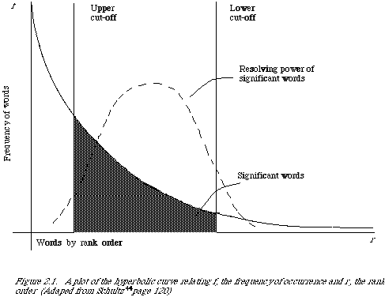
Word Frequency vs. Resolving Power
The most frequent words are not the most descriptive
Diagram from (van Rijsbergen 1979)

Slide 14
Stop words
Stop words are frequent words that are not useful for retrieval
Stop words in text are not used as index terms and are ignored in the query
Generally made up from closed class words
  determiners (the, a, …)
  prepositions (at, by, with, under, above, from …)
  pronouns (he, she, they, them, ….)
  numbers (one, two, three, ….)
  conjunctions (and, or, …)

Slide 15
Stemming
Remaining words in document are generally stemmed as well.
Normalizes index terms to allow more matches
  “dogs” matches “dog”

Slide 16
Inverted Index
Once each document is indexed need to be able to quickly find documents matching each index term.
  Searching each document would take far too long
The inverted index the primary data structure for text indexes
Main idea:
  Create a list of terms occurring in each document
  Invert this to make a list of the documents each term occurs in

Slide 17
Creating an Inverted Index
Documents are processed to extract terms. These are saved with the Document ID.
Now is the time
for all good men
to come to the aid
of their country.
It was a dark and
stormy night in
the country
manor. The time
was past midnight
Doc 1
Doc 2
Doc1: now time good men come aid country
Doc2: dark stormy night country manor time past midnight

Slide 18
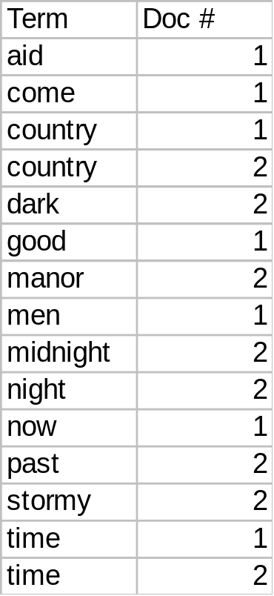
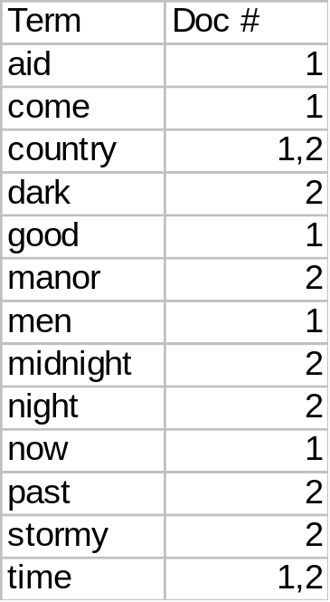
Creating an Inverted Index
Make a list of terms and the documents they occur in
Allows rapid lookup of documents containing a given term

Slide 19
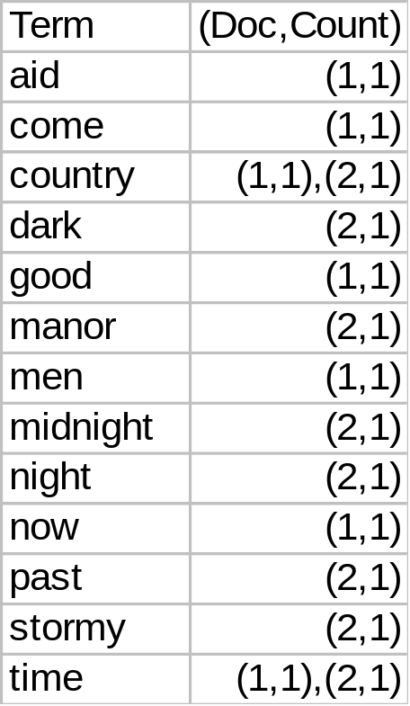
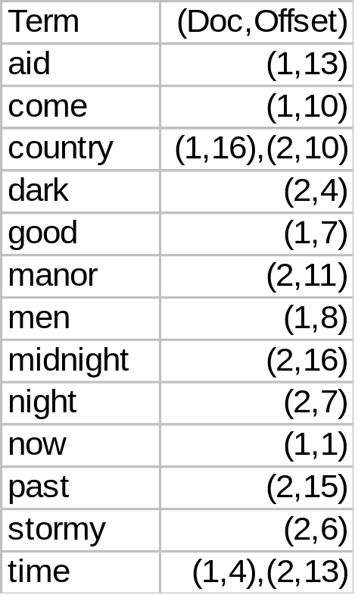
Sophisticated Versions
Include frequency count
for term in document
(Always one in this case)
Include position of term
in document (offset).
Useful to search for
phrases

Slide 20
Information Retrieval: Methods
Boolean search
  Binary decision: is document relevant or not?
  Presence of term is necessary and sufficient for match
Ranked algorithms
  Ranks relevant documents
  Not all search terms necessarily present in model

Slide 21
Bag of words approach
No computer understanding of document or query text
Use “bag of words” approach
Ignore relations between words
  “Venetian blind” = “blind Venetian”
Not perfect, words are
  ambiguous
  used in different forms or synonymously

Slide 22
For Example:
The following query:
“The destruction of the amazon rain forests”
would not trigger a system to find an article about
“Brazilian jungles being destroyed”

Slide 23
Boolean search
  Terms + Connectors (or operators)
  Connectors
    AND
    OR
    NOT
Set theoretic interpretation of connectors
Often used for bibliographic search engines (library)

Slide 24
Boolean Queries
Cat
Cat OR Dog
Cat AND Dog
(Cat AND Dog)
(Cat AND Dog) OR Collar
(Cat AND Dog) OR (Collar AND Leash)
(Cat OR Dog) AND (Collar OR Leash)

Slide 25
Boolean Queries
(Cat OR Dog) AND (Collar OR Leash)
  Each of the following combinations works:
Cat x x x x x x
Dog x x x x x x
Collar x x x x x x
Leash x x x x x

Slide 26
Boolean Queries
(Cat OR Dog) AND (Collar OR Leash)
  None of the following combinations work:
Cat x x
Dog x x
Collar x x
Leash x x

Slide 27
Boolean Queries
  Usually expressed as INFIX operators in IR
    ((a AND b) OR (c AND b))
  NOT is UNARY PREFIX operator
    ((a AND b) OR (c AND (NOT b)))
  AND and OR can be n-ary operators
    (a AND b AND c AND d)
  Some rules - (De Morgan’s Laws)
    NOT(a) AND NOT(b) = NOT(a OR b)
    NOT(a) OR NOT(b)= NOT(a AND b)
    NOT(NOT(a)) = a

Slide 28
Problems with Boolean Search
Boolean searches can be complex to construct
  Expert knowledge usually required to create accurate queries
Pure boolean search does not order retrieved documents
  Frustrating and time consuming to search through results
  In practise results are often ordered by frequency of terms in documents

Slide 29
Vector Space Model
Documents are represented as “bags of words”
Documents are points in a high-dimensional vector space
  Each term forms a dimension so the vectors are generally sparse
Queries are also represented in vector space
Select documents with highest document-query similarity
Document-query similarity is model for relevance (ranking)

Slide 30
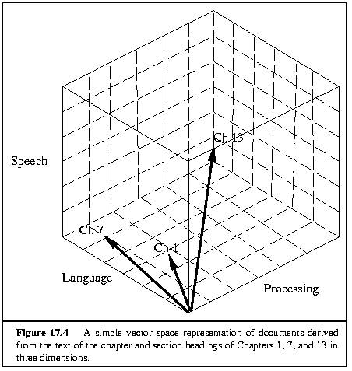
Documents in 3D Space

Slide 31
Document Vectors
A
B
C
D
E
F
G
H
I
star galaxy heat h’wood film role diet fur
10 5 3
5 10
10 8 7
9 10 5
10 10
9 10
5 7 9
6 10 2 8
7 5 1 3
“star” occurs 10 times in text A
“galaxy” occurs 5 times in text A
“heat” occurs 3 times in text A
(Blank means 0 occurrences)

Slide 32
Document Vectors
A
B
C
D
E
F
G
H
I
star galaxy heat h’wood film role diet fur
10 5 3
5 10
10 8 7
9 10 5
10 10
9 10
5 7 9
6 10 2 8
7 5 1 3
“Hollywood” occurs 7 times in text I
“Film” occurs 5 times in text I
“Diet” occurs 1 time in text I
“Fur” occurs 3 times in text I

Slide 33
Document Vectors
Document ids
A
B
C
D
E
F
G
H
I
star galaxy heat h’wood film role diet fur
10 5 3
5 10
10 8 7
9 10 5
10 10
9 10
5 7 9
6 10 2 8
7 5 1 3

Slide 34
We Can Plot the Vectors
Star
Doc about movie stars
Doc about astronomy
Doc about mammal behavior
Diet

Slide 35
Star
Doc about movie stars
Doc about astronomy
Query about movie stars
Doc about mammal behavior
Diet
Query can also be represented as a vector
How do we identify the documents which are most relevant to the query?

Slide 36
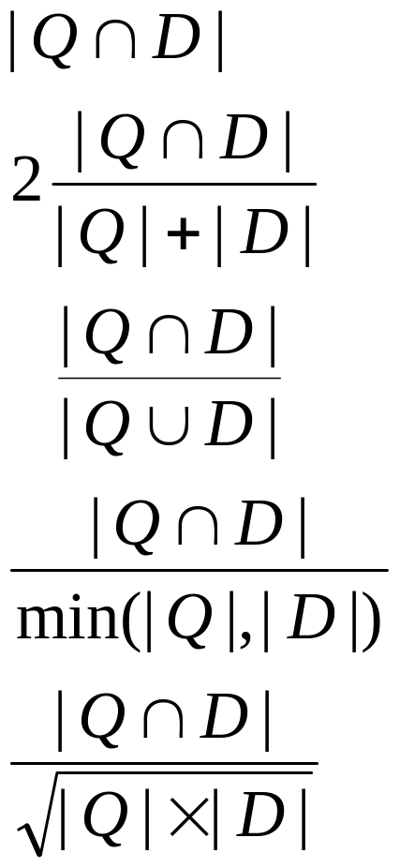
Similarity Measures
Simple matching
Dice’s Coefficient
Jaccard’s Coefficient
Overlap Coefficient
Cosine coefficient
Various measures
can be used to
compare two
vectors
Most commonly used
in vector space model

Slide 37
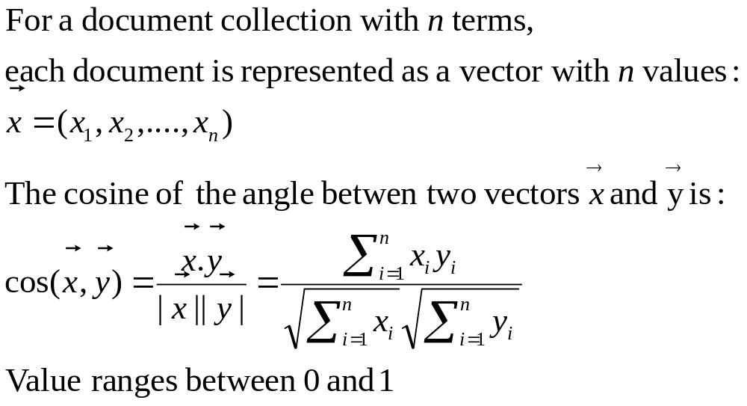
Computing a similarity score

Slide 38
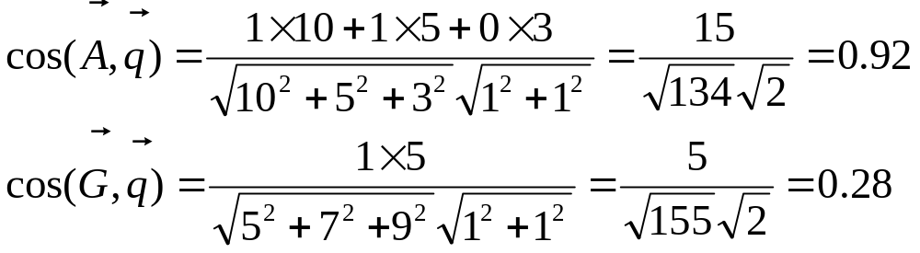
Example
Example query “nova galaxy”
Query vector q = (1, 1, 0, 0, 0, 0, 0,0)
Document A, A = (10,5,3,0,0,0,0,0)
Document G, G = (5, 0, 7, 0, 0, 9, 0, 0)

Slide 39
Assigning Weights to Terms
Raw term frequency
Binary Weights
tf.idf
  Want to weight terms highly if they are
    frequent in relevant documents … BUT
    infrequent in the collection as a whole

Slide 40
Raw Term Weights
The frequency of occurrence for the term in each document is included in the vector
  Easy to fool by placing multiple occurrences of term in a document
  Won’t help if the term is generally frequent in the collection

Slide 41
Binary Weights
Only the presence (1) or absence (0) of a term is included in the vector
A
B
C
D
nova galaxy heat h’wood film role diet fur
1 1 1
1 1
1 1 1
1 1 1
Treats all terms as being equally useful
Term frequency information can be useful

Slide 42
Combined Measure
tf.idf measure:
  term frequency (tf)
  inverse document frequency (idf)
Combines information about how frequent a term is in a document and how frequent it is in the whole collection
Terms which occur frequently in a document but infrequently over the whole collection are generally useful

Slide 43
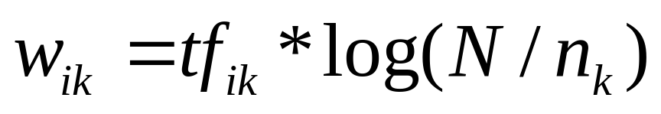
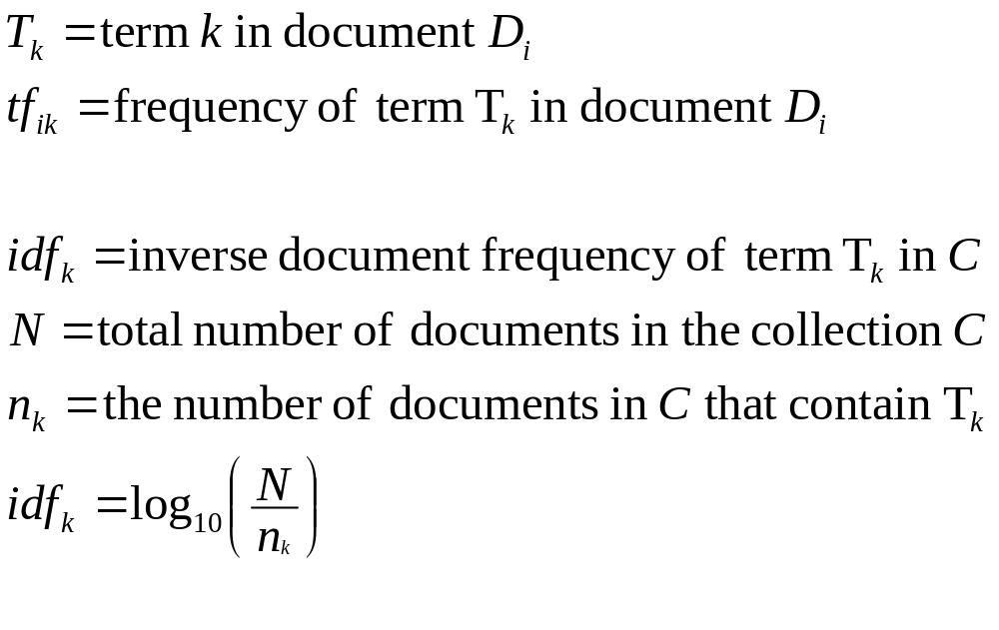
tf x idf

Slide 44
Example
tf.idf weightings for terms in document A.
 | tf_{k} | n_{k} | N | idf | tf.idf
star | 10 | 3 | 9 | 0.477 | 4.77
galaxy | 5 | 3 | 9 | 0.477 | 2.39
heat | 5 | 3 | 9 | 0.477 | 2.39

Slide 45
Problems with Vector Space Model
There is no real theoretical basis for the assumption of a term space
  it is more for visualization that having any real basis
  most similarity measures work about the same regardless of model
Terms are not really orthogonal dimensions
  Terms are not independent of all other terms

Slide 46
Evaluation of IR
Evaluation generally based on idea of document being relevant to a given query
Measurable to some extent
  People may not agree whether a document is relevant
How well does it answer the question?
  Complete answer? Partial?
  Background Information?
  Hints for further exploration?

Slide 47
Evaluation Measures
Precision: the proportion of documents returned by a system which are relevant
Recall: the proportion of the relevant documents in the collection returned by the system
 | Doc is Relevant | Doc is NOT relevant
Doc is retrieved | a | b
Doc is NOT retrieved | c | d
Precision = a / (a + b)
Recall = a / (a + c)
Range between 0 and 1

Slide 48
Precision and Recall
All docs
c
Retrieved
a
b
Relevant
d
All documents = a + b +c + d
Relevant documents = a + b
Precision = a / (a + c)
Recall = a / (a + b)

Slide 49
Precision and Recall
All docs
c = 5
Retrieved
a = 20
b = 10
Relevant
d = 15
All documents = a + b +c + d = 20 + 10 + 5 + 15 = 50
Relevant documents = a + b = 20 + 10 = 30
Precision = a / (a + c) = 20 / (20 + 5) = 0.8
Recall = a / (a + b) = 20+ (20 + 10) = 0.66

Slide 50
Precision and Recall
High precision, low recall
All docs
Retrieved
Relevant

Slide 51
Precision and Recall
Low precision, low recall
All docs
Retrieved
Relevant

Slide 52
Precision and Recall
Low precision, high recall
All docs
Retrieved
Relevant

Slide 53
Precision and Recall
High precision, high recall
All docs
Relevant
Retrieved

Slide 54
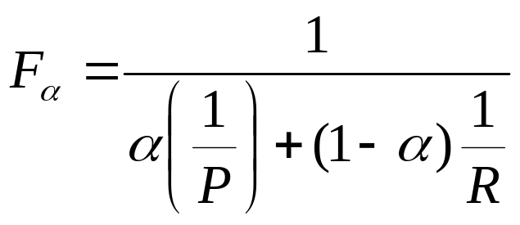
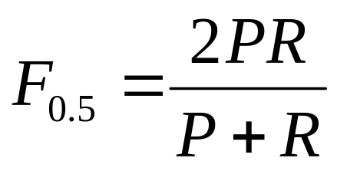
F-Measure
Combine Precision and Recall into one number (van Rijsbergen 79)
P = precision
R = recall
alpha = measure of relative importance of P or R
High alpha: Recall more important
Low alpha: Precision more important
Alpha = 0.5, precision and recall equally important

Slide 55
Relation Between Precision and Recall
There is a tradeoff between precision and recall
  As more results are examined precision generally drops while recall increases
Various methods for evaluating system across all results have been suggested
  Precision at cut-off
  Average precision
precision
recall

Slide 56
Precision at a cutoff
Gives an impression of how well a method ranks relevant documents before non-relevant documents
Choose some number of documents to be retrieved and compute the precision at that point

Slide 57
Example
Evaluation | Ranking 1 | Ranking 2 | Ranking 3
 | d1: / | d10: X | d6: X
 | d2: / | d9: X | d1: /
 | d3: / | d8: X | d2: /
 | d4: / | d7: X | d10: X
 | d5: / | d6: X | d9: X
 | d6: X | d1: / | d3: /
 | d7: X | d2: / | d5: /
 | d8: X | d3: / | d4: /
 | d9: X | d4: / | d7: X
 | d10: X | d5: / | d8: X
Precision at 5 | 1.0 | 0.0 | 0.4
Precision at 10 | 0.5 | 0.5 | 0.5

Slide 58
Average Precision
Aggregates many precision scores into one evaluation figure
(Uninterpolated) Average Precision
  Precision computed for each point a relevant document is found and average
Interpolated Average Precision
  Precision computed at various levels of recall and average
  Usually computed at 0%, 10%, 20% .. 100% recall, 11 levels in total

Slide 59
Uninterpolated Example
Evaluation | Ranking 1 | Ranking 2 | Ranking 3
 | d1: / (1/1) | d10: X | d6: X
 | d2: / (2/2) | d9: X | d1: / (1/2)
 | d3: / (3/3) | d8: X | d2: / (2/3)
 | d4: / (4/4) | d7: X | d10: X
 | d5: / (5/5) | d6: x | d9: X
 | d6: X | d1: / (1/6) | d3: / (3/6)
 | d7: X | d2: / (2/7) | d5: / (4/7)
 | d8: X | d3: / (3/8) | d4: / (5/8)
 | d9: X | d4: / (4/9) | d7: X
 | d10: X | d5: / (5/10) | d8: X
Average Precision | 1.0 | 0.3544 | 0.576

Slide 60
Interpolated Average Precision
Precision computed at various levels of recall and average
  Usually computed at 0%, 10%, 20% .. 100% recall, 11 levels in total
Precision is interpolated:
  Highest precision value beyond point where given recall value is reached
  Based on assumption use will be willing to look at more documents if precision goes up

Slide 61
Interpolated Example
Ranking 3 | Precision | Recall | RLevel | Interpolated Precision
d6: X | 0 | 0 | 0% | 2/3
d1: / | 1/2 | 1/5 | 20% | 2/3
d2: / | 2/3 | 2/5 | 40% | 2/3
d10: X | 2/4 | 2/5 | 40% | 5/8
d9: X | 2/5 | 2/5 | 40% | 5/8
d3: / | 3/6 | 3/5 | 60% | 5/8
d5: / | 4/7 | 4/5 | 80% | 5/8
d4: / | 5/8 | 5/5 | 100% | 5/8
d7: X | 5/9 | 5/5 | 100% | 5/8
d8: X | 5/10 | 5/5 | 100% | 5/8
Interpolated average precision = (5 x (2/3) + 6 x (5/8)) /11 = 0.644

Slide 62
Summary
Document indexing
  Manual indexing
  Automatic indexing
    Stop word removal, stemming, inverted indexes
Information Retrieval models
  Boolean model
  Vector space model
    Cosine measure, term weighting
Evaluation of Information Retrieval
    Precision, recall and F-measure
    Precision at cut-off, average precision

